Slide 1
Traffic Camera Tracker
By: Ian, Abdi, and Maryann

Slide 2
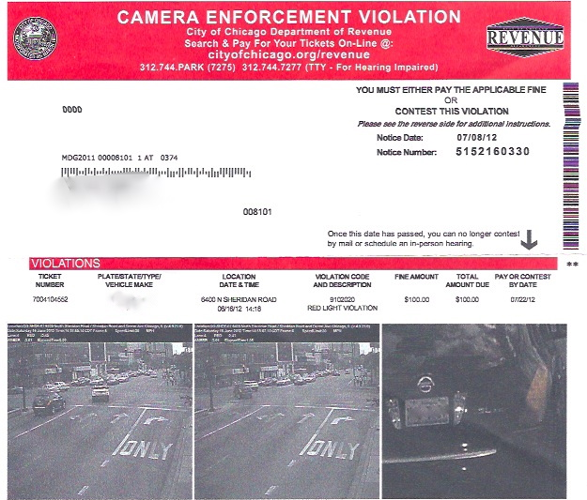
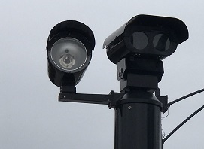
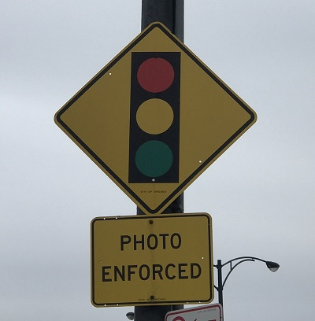
Application Concept and Motivation
Keep track of all traffic cameras in the city of Chicago
Know your own neighborhood’s cameras and avoid a ticket in the mail
Plan a trip into the city knowing where the cameras you will come across are located

Slide 3
Design Process
Abdi – Senior Front End Designer
Maryann – Senior Database Administrator
Ian – Senior JavaScript Developer

Slide 4
Technologies Utilized
Front End:
CSS, HTML
Bootstrap
Back End
jQuery, JavaScript
Scalable Vector Graphics file notation
Google Maps API
City of Chicago API and Firebase Database

Slide 5
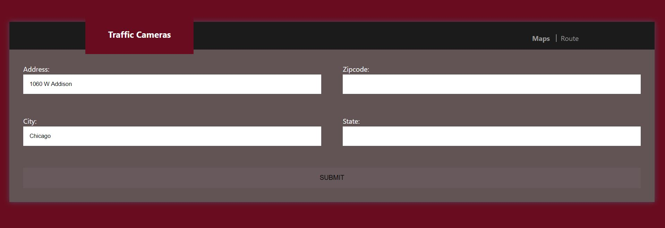
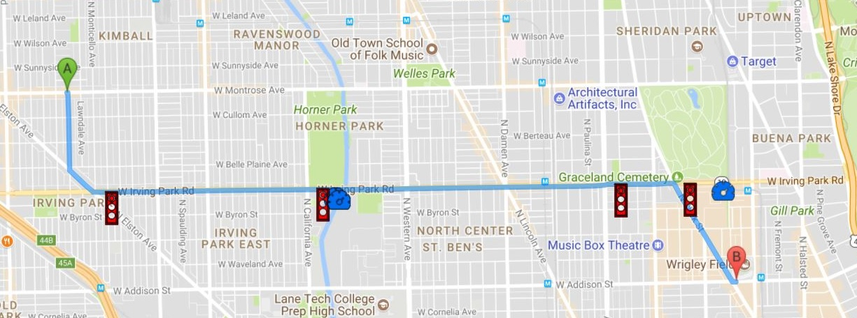
Functionality
https://icmitchell.github.io/Traffic-Cameras/

Slide 6
Future Additions
Incorporate real-time tracking and warnings for cameras ahead of you
Expand outside of Chicago city limits
Include other datasets relevant to average drivers (parking restrictions, speed trap locations, etc.)

